Slide 1
Writing Clean Code
AI2C Tech Intro

Slide 2
Objectives
Understand the importance of “clean code”
Identify “code smells”
Utilize tooling and processes to improve code quality
(buckle in)

Slide 3
They Write the Right Stuff

Slide 4
The Agile Manifesto

Slide 5
How do they compare?

Slide 6
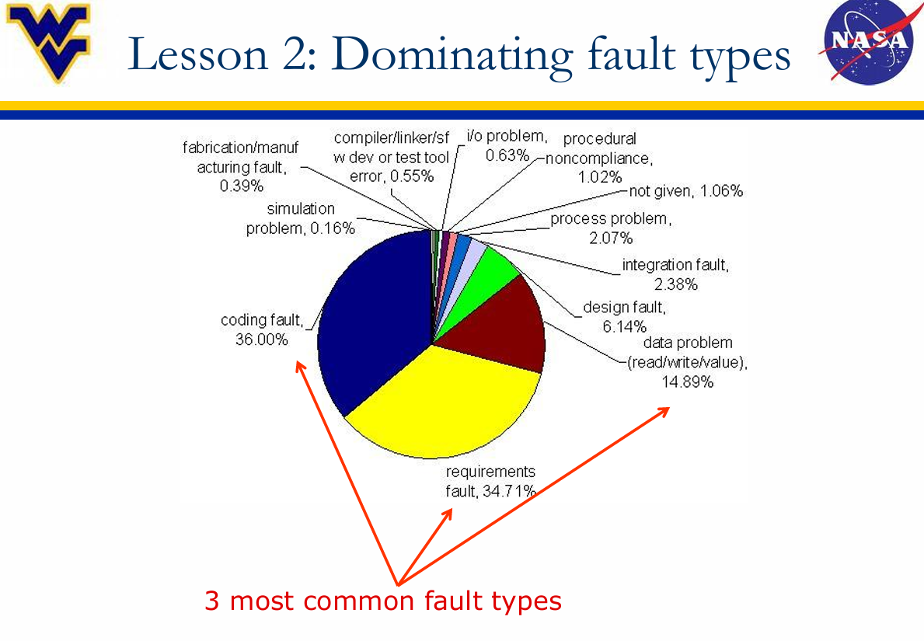
Does it matter?
Notes:
https://www.nasa.gov/wp-content/uploads/2016/10/585637main_swfaultsfailuresfixes.pdf
https://raygun.com/blog/costly-software-errors-history/

Slide 7
Python Styling

Slide 8
PEP 8

Slide 9
PEP 20

Slide 10
Don’t Repeat Yourself

Slide 11
So what’s the deal?
How do you apply these ideas?
Notes:
We’ll look at select examples moving forward

Slide 12
Objects, Inheritance, Composition
OOP is a powerful way (to shoot yourself in the foot)
Composition over inheritance
Promotes loose coupling

Slide 13
Modules

Slide 14
Design Patterns

Slide 16
Tooling
Static analysis
Formatters (black)
Linters (pylint)
Dynamic analysis
Debuggers
Profilers
Notes:
https://github.com/analysis-tools-dev/dynamic-analysis?tab=readme-ov-file#python

